Slide 1
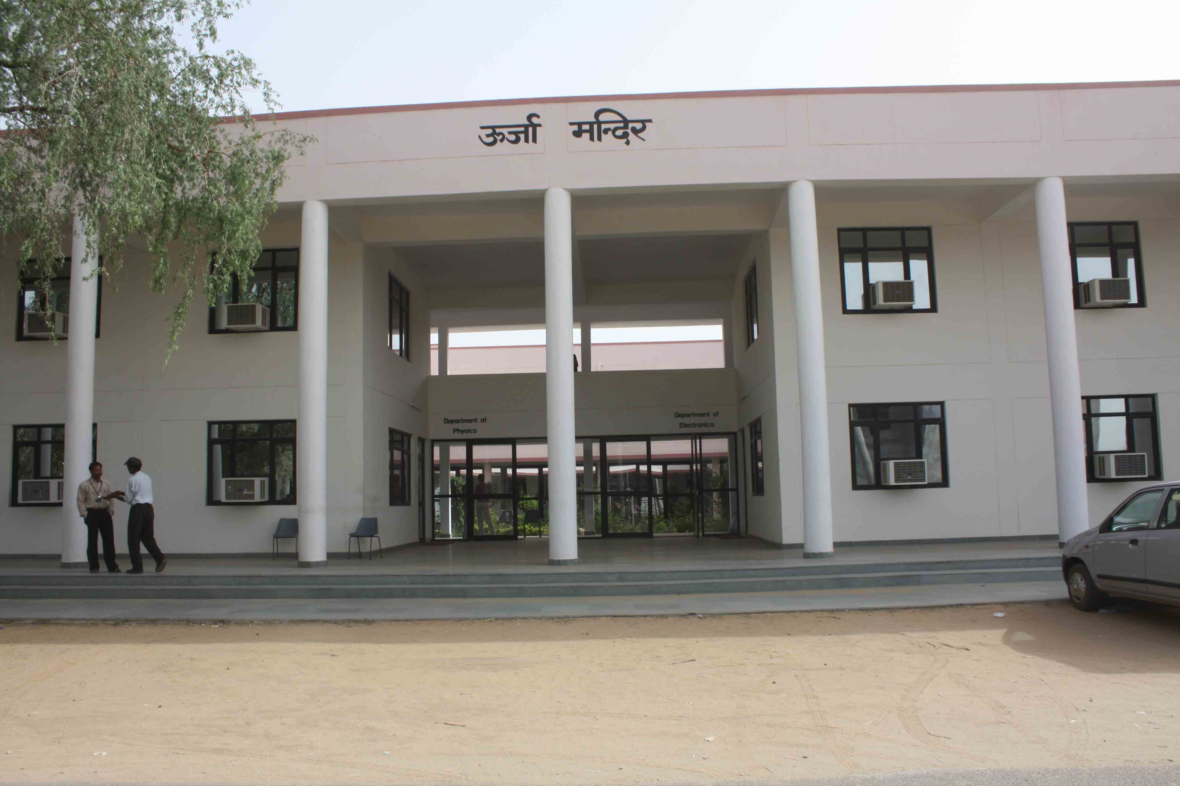
School of Physical Sciences
Banasthali Vidyapith

Slide 2
Five Year Accomplishment

Slide 3
Laboratories Developed
Material Synthesis Lab
Fume Hood
Photocatalytic Reactor
Slot die Coater
Dip Coater
Ultra probe Sonicator
UV-Ozone Cleaner
Vacuum oven

Slide 4
Cont...
Material Characterization lab
Field Emission Scanning Electron Microscope
Micro Raman Imaging Spectrometer
Spectroscopic Reflectrometer

Slide 5
Cont…….
Device Fabrication and characterization Lab
DC/Pulsed DC/RF Sputtering System for thin film deposition
Thermal Vacuum coating unit
Glove box
Differential Scanning Calorimetry
Solar simulator
Source Meter for I-V measurement
Tube furnace

Slide 6
Cont...
VLSI Design Lab
Antenna design Lab
Advanced Communication Engineering Lab

Slide 7


Thrust areas of Research
    Energy harvesting
    Optoelectronic devices
    Material Science
    Polymer Technology
    MEMS Technology
    Microwave Electronics
    Image Processing
    Communication System
    VLSI design

Slide 8
projects
    UGC Project (2)
    UGC-DAE CRS (1)
    DST-TARE (1)
    DST-SERB (1)
    60 Lakhs
Institutional Project
      DST-CURIE (3 Phases)
      MHRD-FAST

Slide 9

Research Outcome
Faculty members of the School of Physical Sciences published more than 200 research articles listed in Scopus.

Slide 10
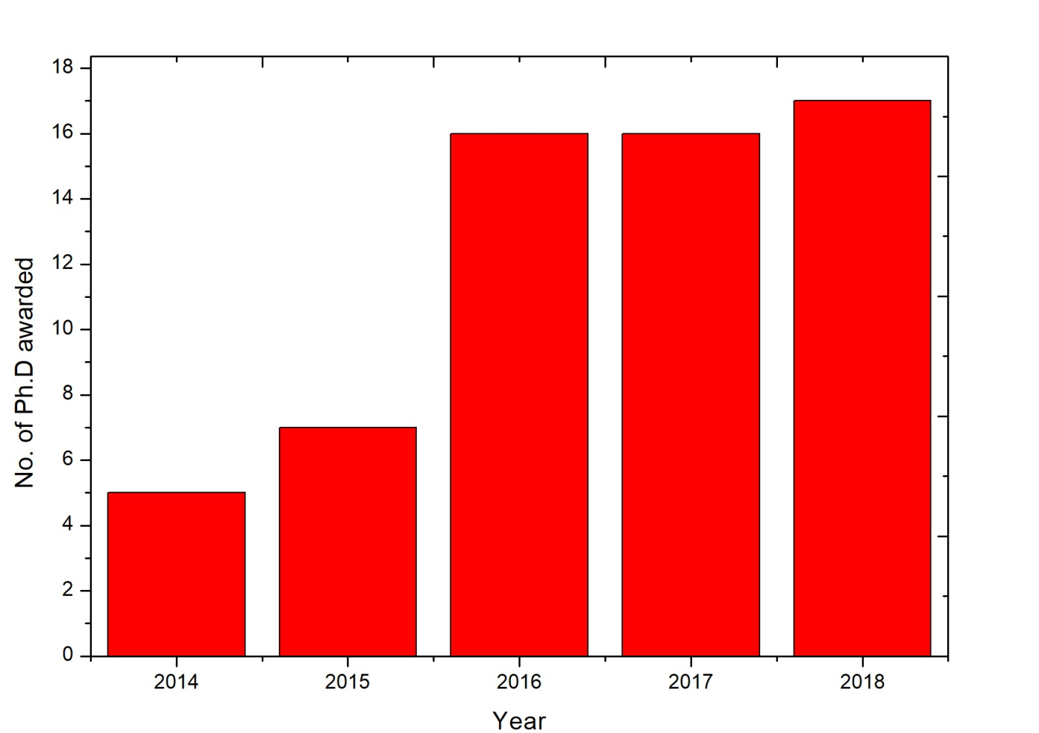
Research Outcome…..
Ph.D. Awarded during 2014-18

Slide 11

Five Year Plan (2019-24)
STRATEGIC OBJECTIVES
Enrich and advance Teaching/Learning
Improve research reputation of the School
New Courses
New centre of Excellence

Slide 12
Commitment (2019-24)
` | 2019-20 | 2020-21 | 2021-22 | 2022-23 | 2023-24
Publications | 90 | 100 | 110 | 125 | 150
Ph.D. Enrolment | 38 + 12 | 20 | 22 | 25 | 30
Project Submission | 4 (50 Lakhs) | 5 (60 Lakhs) | 6 (80 Lakhs) | 7 ( 1 crore) | 10 (1.5 crore)
Patent |  | 2 |  |  | 3

Slide 13
Enrich and advance Teaching/Learning
Impart life-long self-learning skills that utilize fundamental concepts to solve problems.
Provide hands-on practice opportunities.
Through promote active learning.
Provide ample opportunities for undergraduate research participation.

Slide 14
Cont…
Improve research reputation of the School
Pursue research in core Electronics, Physics and related interdisciplinary areas to enhance quality of life and to develop fundamental knowledge (e.g. understand long terms problems) and enabling technologies that serve society and address the most pressing global challenges.

Slide 15
Cont…
Improve research reputation of the School
To continue to focus on a few important areas of excellence (Photonics, Polymer technology, Communication systems, Image processing, Devices & Technology) that will create outstanding programs of research and innovation.

Slide 16
Cont…….
New Emerging areas of Research:
To be aggressive and opportunistic in pursuit of emerging areas of Electronics and Physics (semiconductor optoelectronics, Energy Harvesting, Flexible Electronics, RF and Microwave, Antenna design, and MEMS).
Arrange weekly meeting/discussion/presentation among the members of the research group.
Grow departmental resources & optimize their use to support goals in education, research, and service.
LAB Development

Slide 17
Cont…….
Fund Raising:
Actively seek funding from state, central and industry especially with a view to establish a national centre (Planning to submit at least 4 proposals in next academic year)

Slide 18
Cont…….
Publications:
Encourage to submit the manuscript only in the Science citation indexed (SCI) journals. ( commit to publish at least 90 papers in next academic year)
Patent:
Transfer knowledge into products and processes. Encourage to submit more than one patent within 2 years.

Slide 19
New Centre of Excellence
Photonics
Flexible electronic devices
Nanotechnology

Slide 20
Thank you

