Slide 1

Research Roadmap
Department of Chemistry

Slide 2
In Department of Chemistry, there are sixteen members in the teaching staff of Chemistry.
All are Ph.Ds., out of these nine members are approved Ph.D. research supervisors.
In all about thirty research scholars have been pursuing their research work in various thrust areas programmes of research in chemistry.

Slide 3
Thrust Areas of Research
Organic Synthesis and medicinal Chemistry
Green Chemistry
Advanced Functional Materials & Interfaces
Natural Product Chemistry

Slide 4
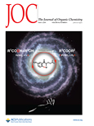
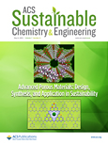
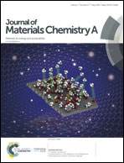
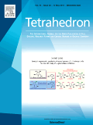
Publications in last five years
Publications
>225
Citations
>2000
Impact Factor per paper: 1.6 (Top 200)
IF-6.14
IF-4.8
IF-2.3
IF-9.9

Slide 5
Achievements in Research (2014-18)
Paper Published: 248
Paper Per Faculty: 13.8
Total Impact Factor: 325
Average Impact Factor of Top Ten papers: 5.92
Impact Factor per paper: 1.68
Total citation: 1980
Citation per faculty: 141.42

Slide 6
Cont….
Project in hand (DST, Fast Track):01
Project completed (UGC, Major):01
In addition, Department has also been operating projects received from DST CURIE, MHRD and (WTP) DST.
Patent Filed: 01

Slide 7
Department plans to improve further its quality
of research:
By submitting active research proposals to various funding agencies in the following thrust areas (~ 150 lacs);
Individual research project applied-05
(DAE/DST) in the following trust areas:
Water (Development of Nanoadorbents and nanosensors)
Medicinal Chemistry (Synthesis of anti-microbial and anticancer agents)
DST FIST- Phase II –(Ready for submission)

Slide 8
Objective for next five years
Department will Continue Nurturing of three P,’s
Publications: ~ 250
Patent: 2
Project: 4

Slide 9
Thank you

